Slide 1

RSpace overview
for
Harvard DataFest
Rory Macneil and Rob Day
January 21 2020

Slide 2

Today
RSpace context and overview (Rory)
Demo (Rob Day)
Q&A

Slide 3
What is RSpace?
‘Google Docs for Science’
Collaborative research tool
Electronic Lab Notebook
Jupyter for non-computationalists
Part of the research IT infrastructure

Slide 4
Which disciplines use RSpace?
Medical research
Biology
Chemistry
Biochemistry
Biomedical and chemical engineering
Physiology
Psychology
Plant science
Materials science
Nanotechnology
Physics
Astronomy
Etc.

Slide 5
About us
Spinout from the University of Edinburgh
Designed to requirements developed with the University of Wisconsin
Subsequent development working with researchers at Edinburgh, Goettingen, Harvard and elsewhere
Design principles
  Flexibility
  Connectivity
  Traceability

Slide 6
1. Flexibility
“Other ELNs force you into an often constrictive workflow; RSpace provides support for enhancing your workflow.”
Notebook AND/OR folders
Documents AND/OR forms
RSpace AND/OR other tools
  Import AND/OR link to

Slide 7
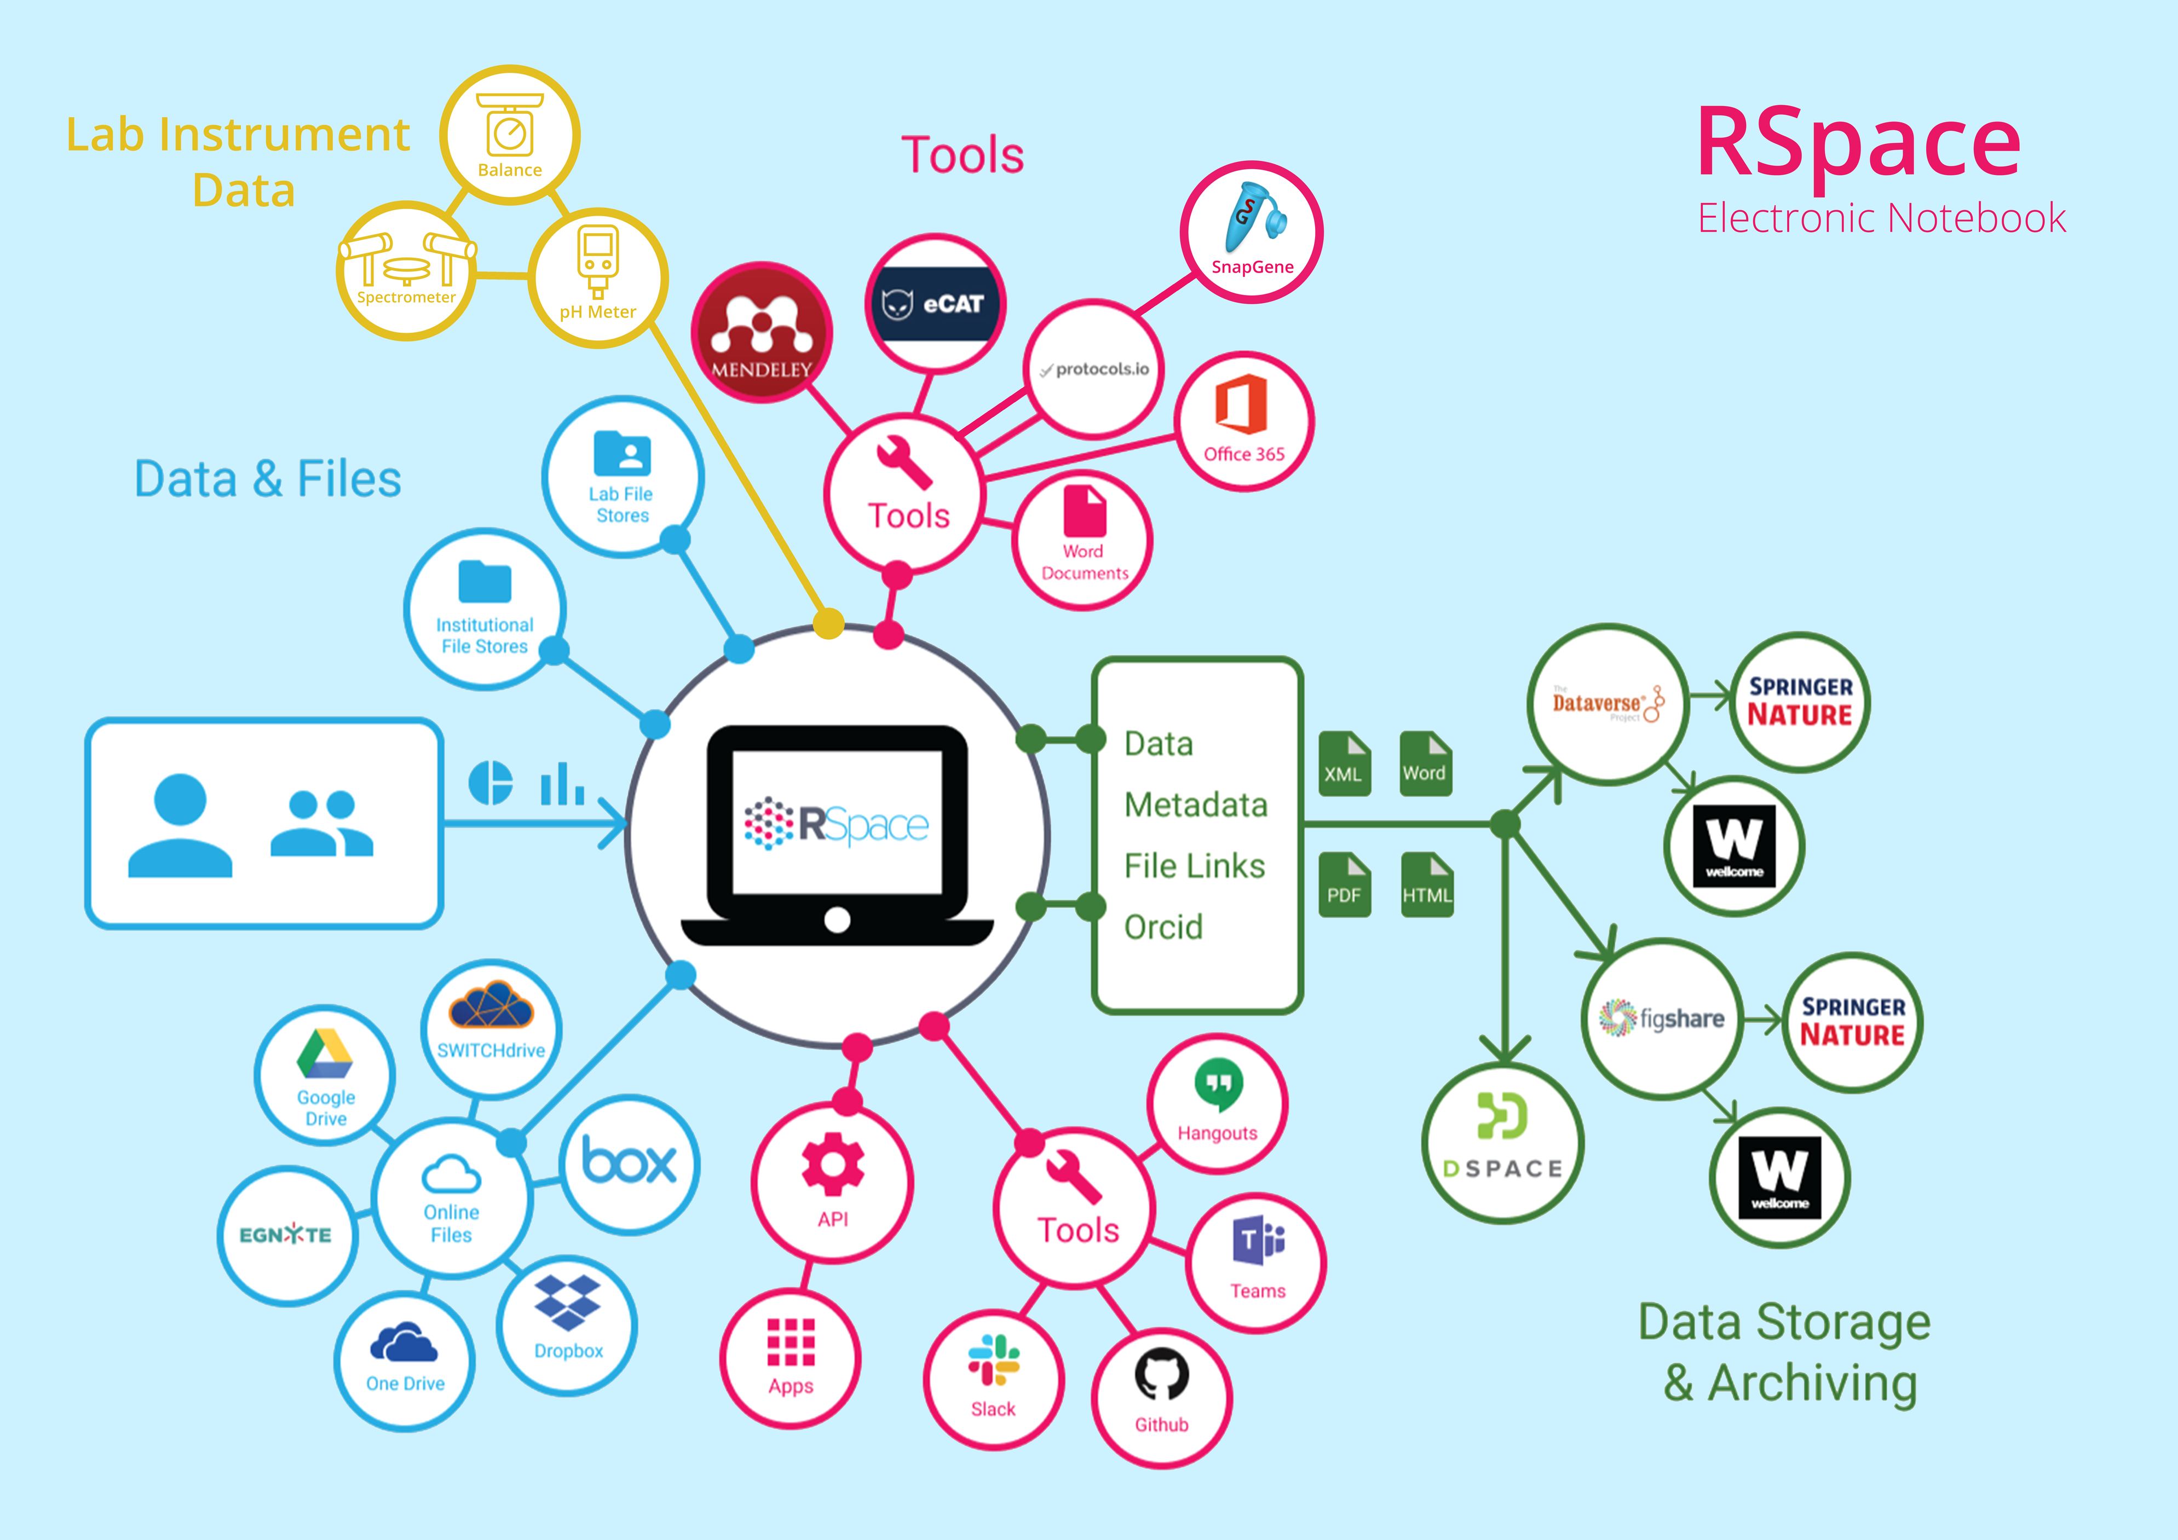
2. The Connected Approach enables
inter-operability and supports reproducibility

Slide 8
3. Traceability
Unique IDs for documents and forms
Linking between documents
Exports include linked documents
Integrations with data repositories

Slide 9
Chemistry
No modern, affordable ELN has good support for chemistry
We are working with Harvard Department of Chemistry and Chemical Biology to change that!
Existing chemistry capabilities in RSpace (ChemAxon partnership)
  Draw chemical structures
  Search structures and substructures
  Import Chemdraw files
  Import multiple compounds
  Calculations: weight, formula, mass
Coming enhancements
  Handling reactions
  Stoichiometry
Integrations with ChemAxon tools
  Assay data upload
  Compound registration

Slide 10
Roadmap
SnapGene integration (in progress)
  Viewing map and sequence displays
  Adjusting map and sequence formats
  Annotating primer binding sites
  Obtaining
      A list of features
      A list of primers
      A list of restriction sites
      A list of open reading frames
  Converting between file formats
Support for automatic ingest of
  Additional categories of instrument data, e.g. sequencing data
  Voice data (HelixAI integration)
Jupyter integration

Slide 11
Secure, Compliant and Enterprise-ready
Security
Compliance
Deployment
Group set up and training

Slide 12
Harvard rollout
Late January/early February start
Harvard Key sign in
Help with
  Setting up groups
  Training
Support from
  Your department
  The library (Suzanne Wones)
  Research Computing
  Research Space

Slide 13
Contact Merce Crosas (mcrosas@g.harvard.edu)
to learn more/ask for an account

